Slide 1

Notes:
Good morning everyone. My name is Parastoo Hashemi, and my teammate Yousef Fayyaz, we’re here to present the progress for our project titled Multi-Task Learning for Fire Ignition Maps.
In this presentation, we focus on the technical foundation we’ve built—mainly the dataset exploration, preprocessing, and the implementation of our baseline model.

Slide 2
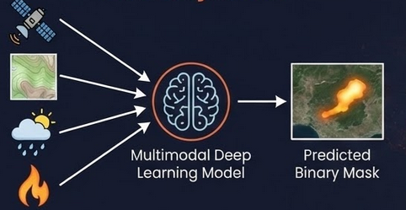
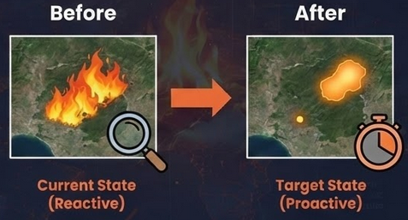
Project Objective
Core Objective
To develop a multimodal deep learning model capable of Predicting the final burned area extent right at the moment of ignition, using only pre-fire multimodal data that fused into a multimodal model
Input: Pre-fire environmental data (Satellite, Topography, Weather) + Ignition Point.
Output: Predicted binary mask of the final burned area.
The Paradigm Shift
Current State (Reactive): Remote sensing is primarily used for post-event damage assessment.
Target State (Proactive): To estimate the spread of fire immediately to allocate resources immediately during the "Golden Hour".
Notes:
Our project aims to predict the final burned-area extent right at the moment of ignition, using only pre-fire environmental information. Today, remote sensing is mostly reactive—they map what burned after the event. Our goal is proactive: to estimate the spread of fire immediately, during ‘Golden Hour’, when early decisions can drastically change the outcome.
Our model will fuse multiple data sources to produce a predicted burned-area mask.

Slide 3




Value Proposition
Response Efficiency
Innovation & Scalability
Environmental Impact
The multimodal AI system generalizes across regions where Sentinel-2, Landsat, DEM, ERA5, and infrastructure layers are available.
The framework can be replicated globally, providing a reusable template for data-driven wildfire risk management.
Proactive predictions reduce environmental losses by enabling faster response before uncontrolled spread.
Fewer hectares burned → lower CO₂ emissions, preserved ecosystems, and reduced long-term regeneration costs.
Early burned-area forecasts help Civil Protection allocate firefighting teams, helicopters, and ground units efficiently.
Better situational awareness during the first critical hours improves containment and reduces operational risk.
Notes:
This work is meaningful for three main reasons.
First, environmental impact: early predictions can reduce the area burned, CO₂ emissions, and ecological damage.
Second, response efficiency: Civil Protection can position teams, helicopters, and ground units before the fire happens.
And third, scalability: because all our data layers are globally available, the same methodology could be replicated in other fire-prone areas.

Slide 4
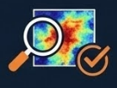
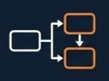
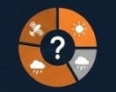
Research Questions
Can pre-fire multimodal data predict final burned area with sufficient accuracy to support early emergency decisions?
Why are standard metrics (accuracy) insufficient for spatial wildfire decision-making?
which input data modalities contribute most to predictive performance?
Notes:
Our research revolves around three key questions:
Can multimodal pre-fire data actually predict the final burned area with useful accuracy?
Does adding an auxiliary task—such as land-cover segmentation—improve the burned-area prediction?
And finally, which modalities matter most?

Slide 5
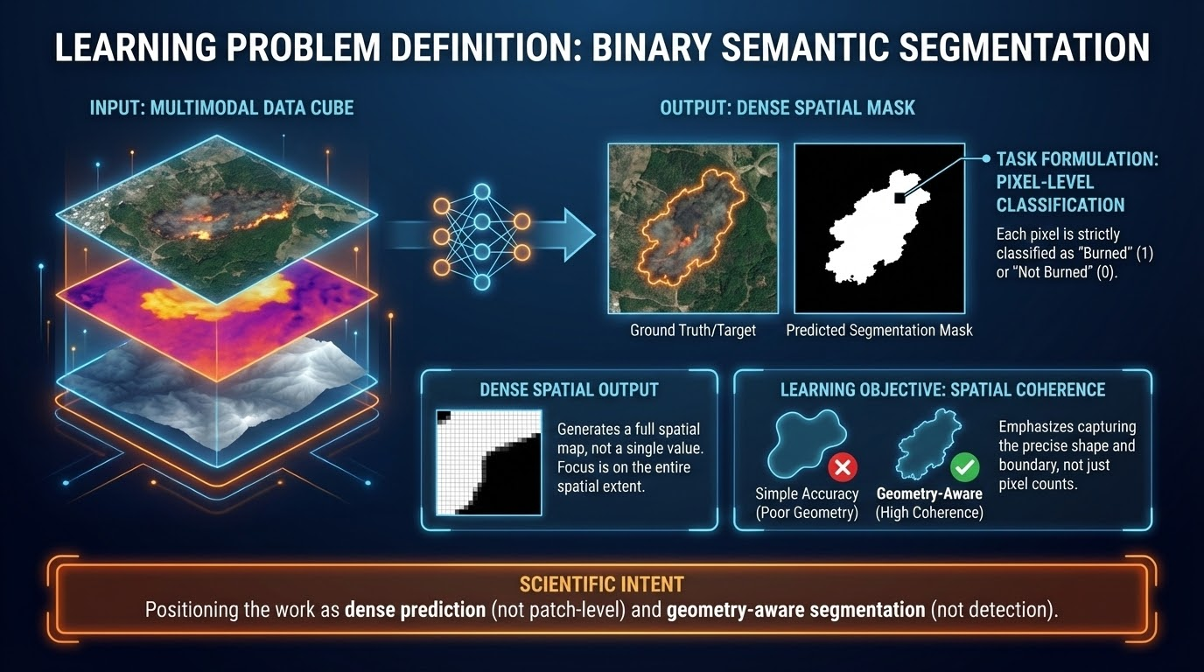

Slide 6
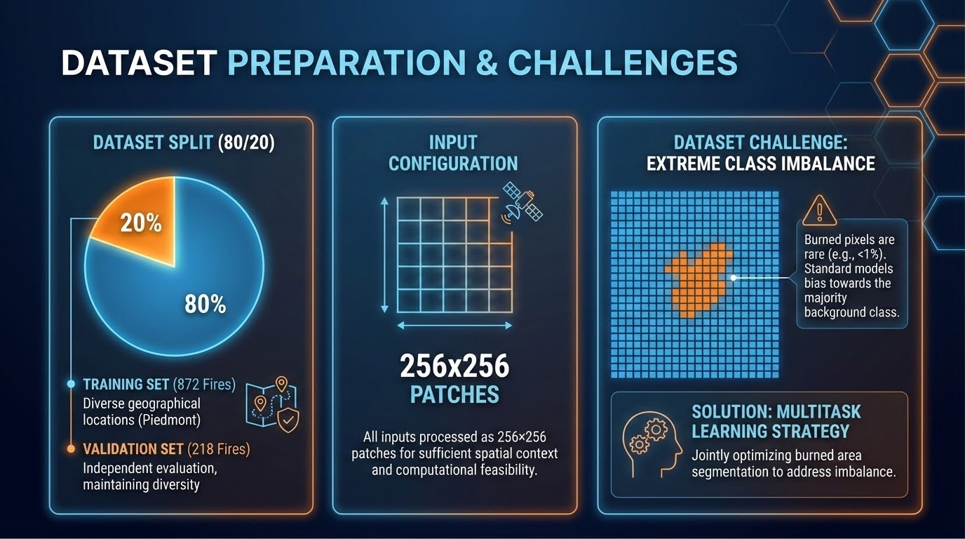

Slide 7
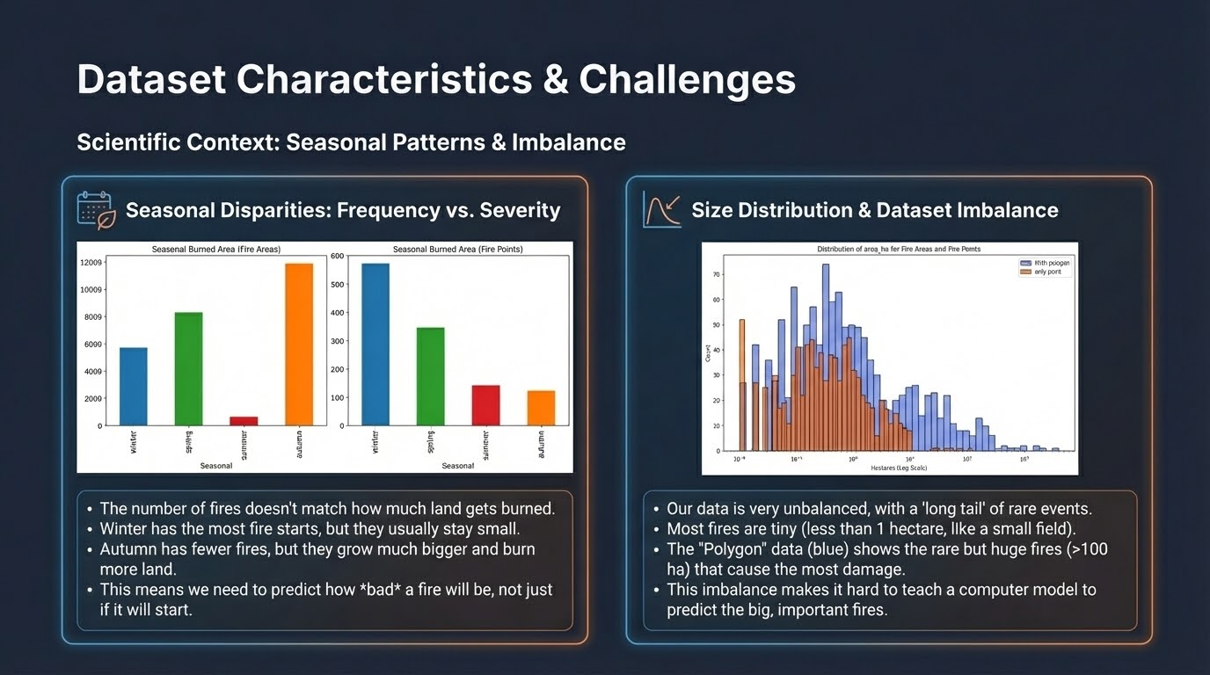
Notes:
“The dataset exhibits two major scientific challenges.
First is seasonal disparity: autumn fires are fewer but burn much more land,
while winter fires are frequent but small.
This means frequency does not predict severity.
Second is heavy class imbalance.
Most fires are extremely small, while a few large events dominate the total burned area.

Slide 8
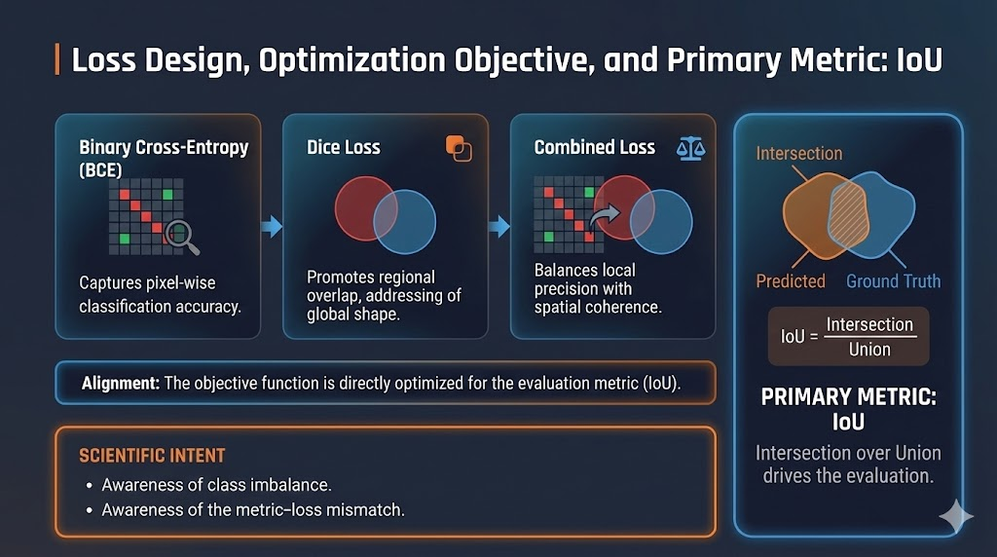

Slide 9
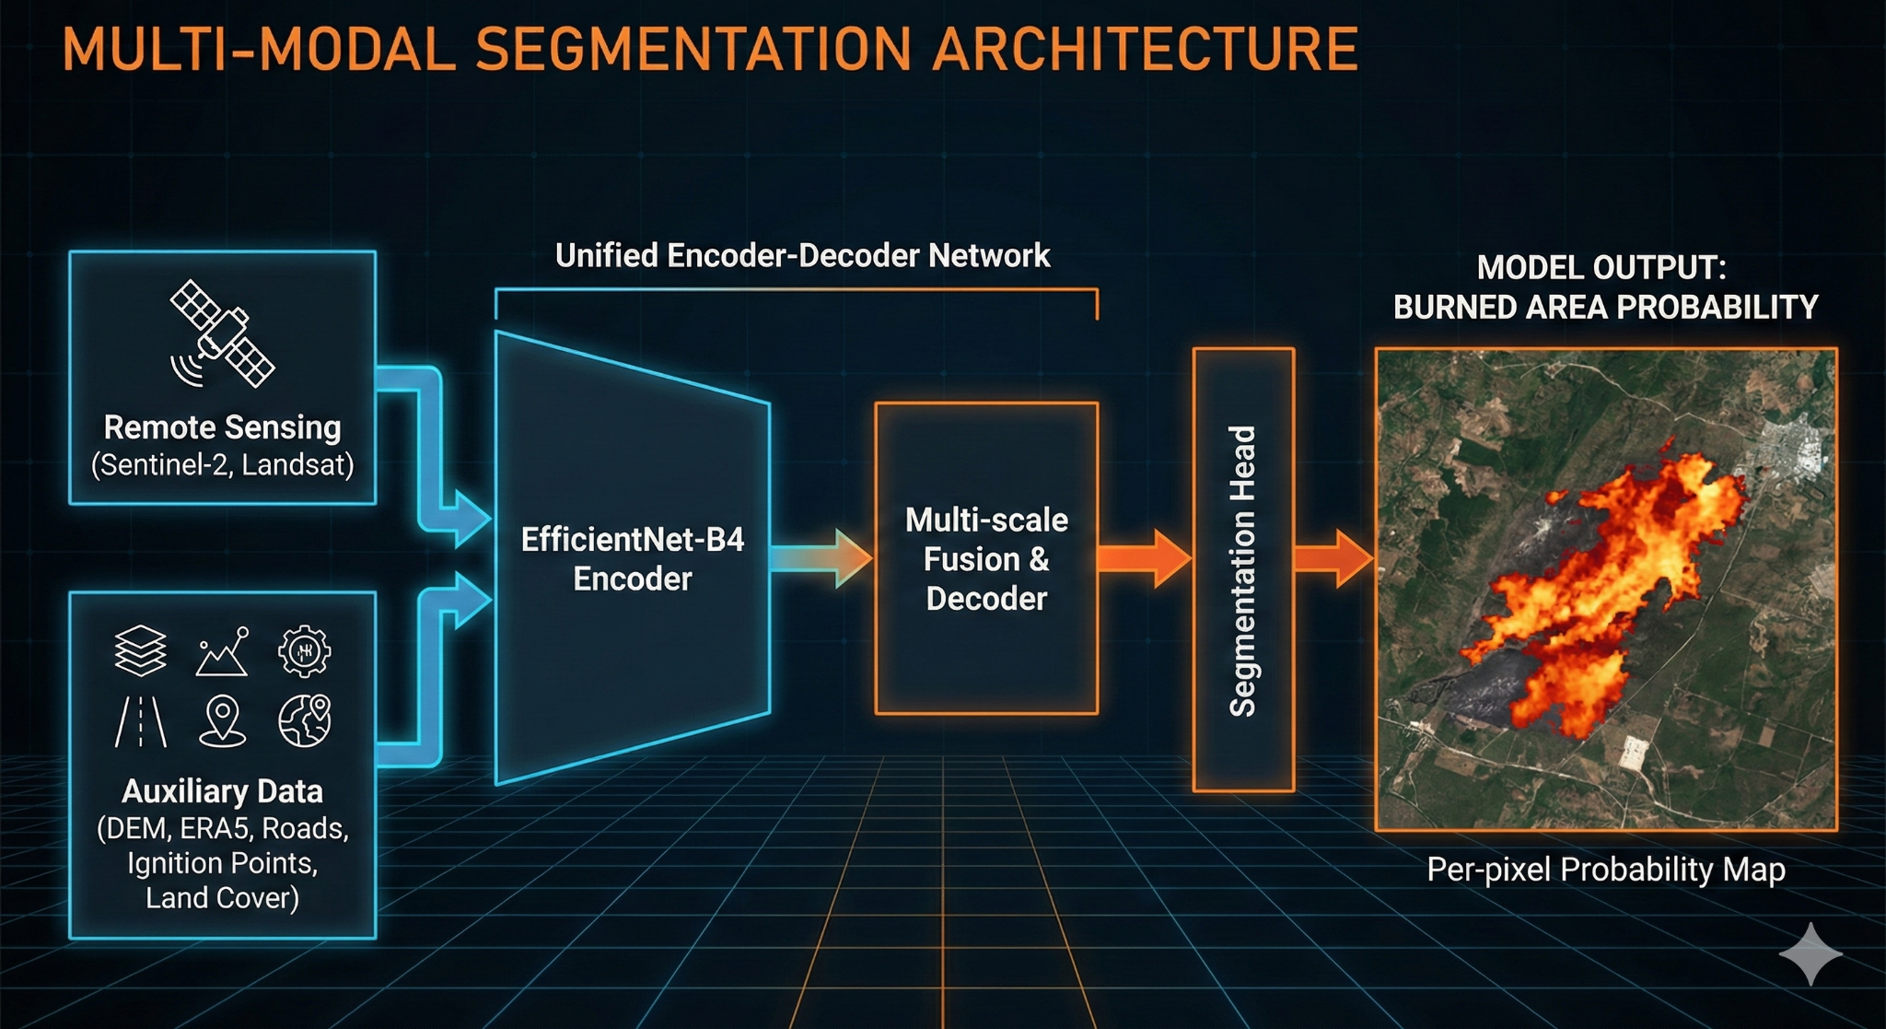

Slide 10
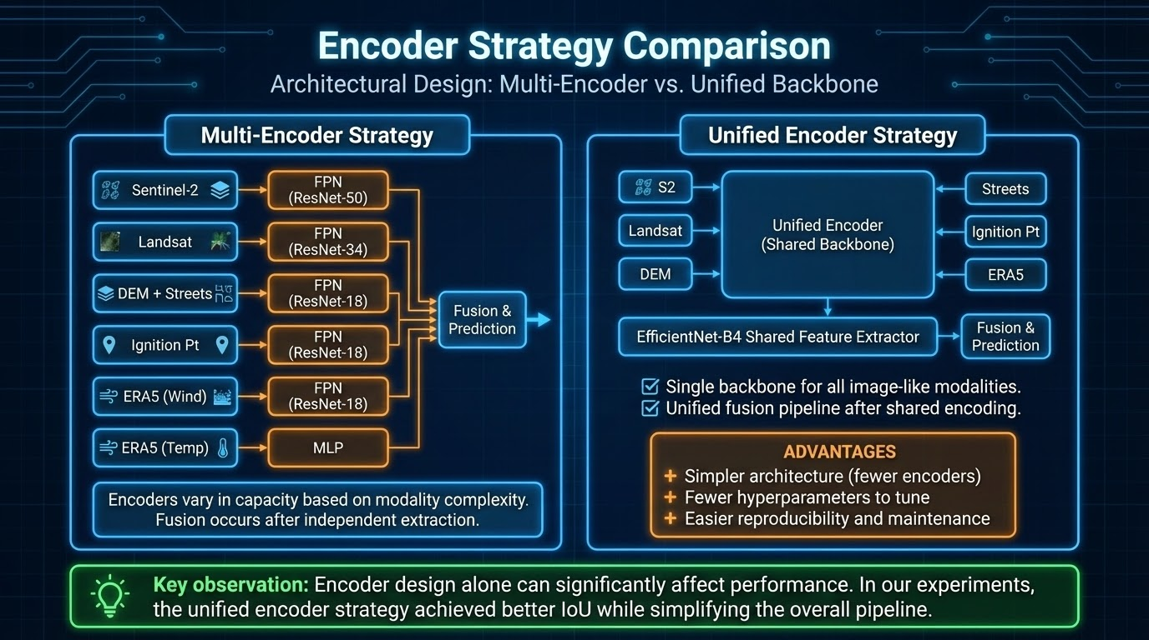

Slide 11
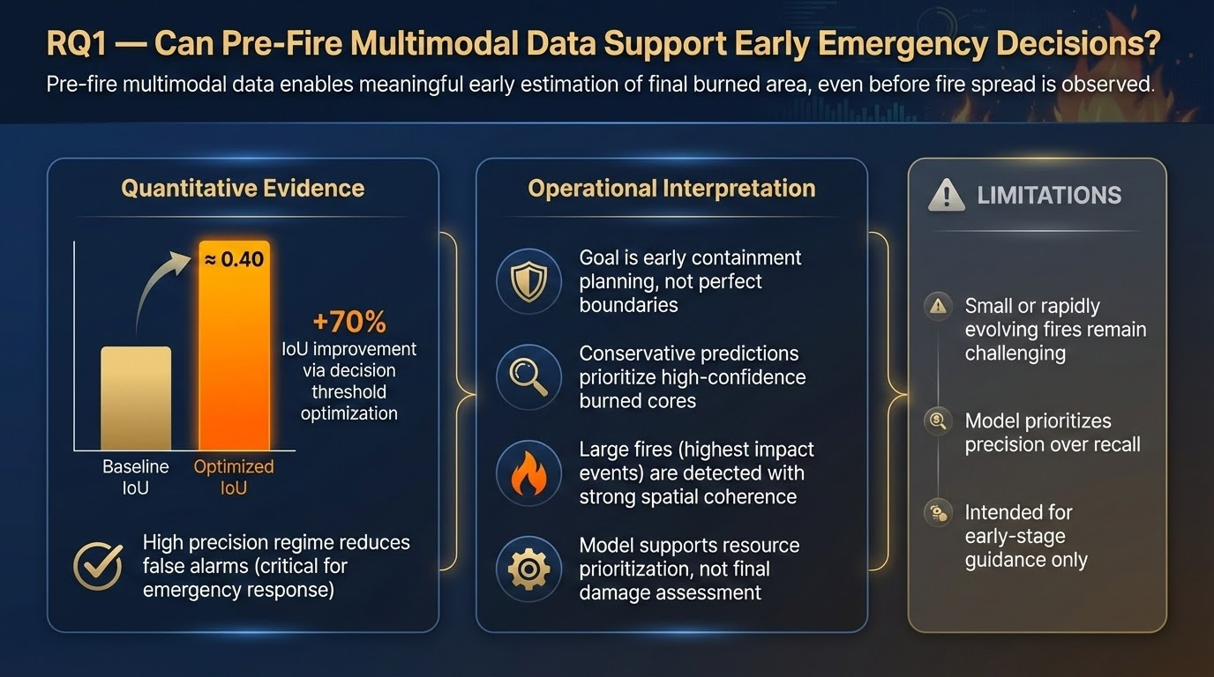

Slide 12
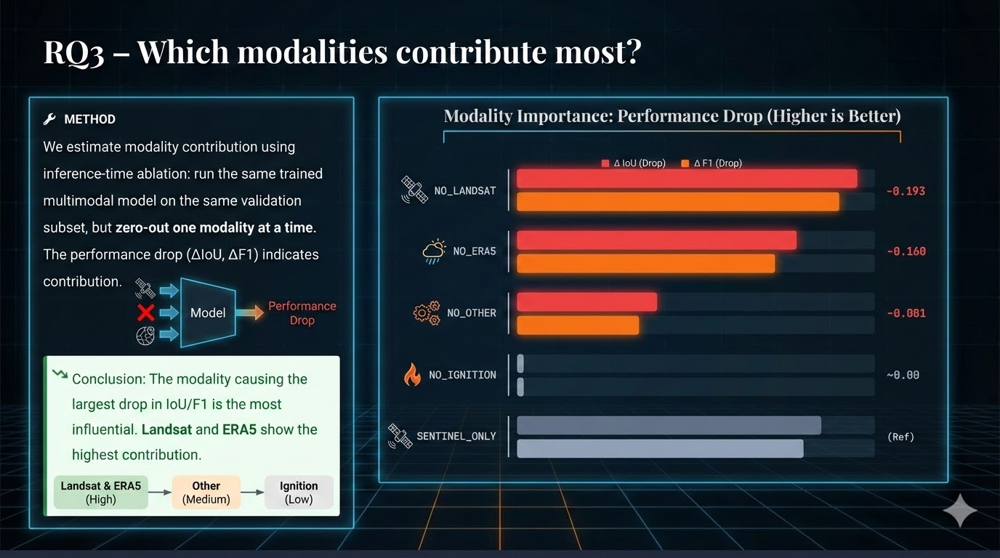

Slide 13
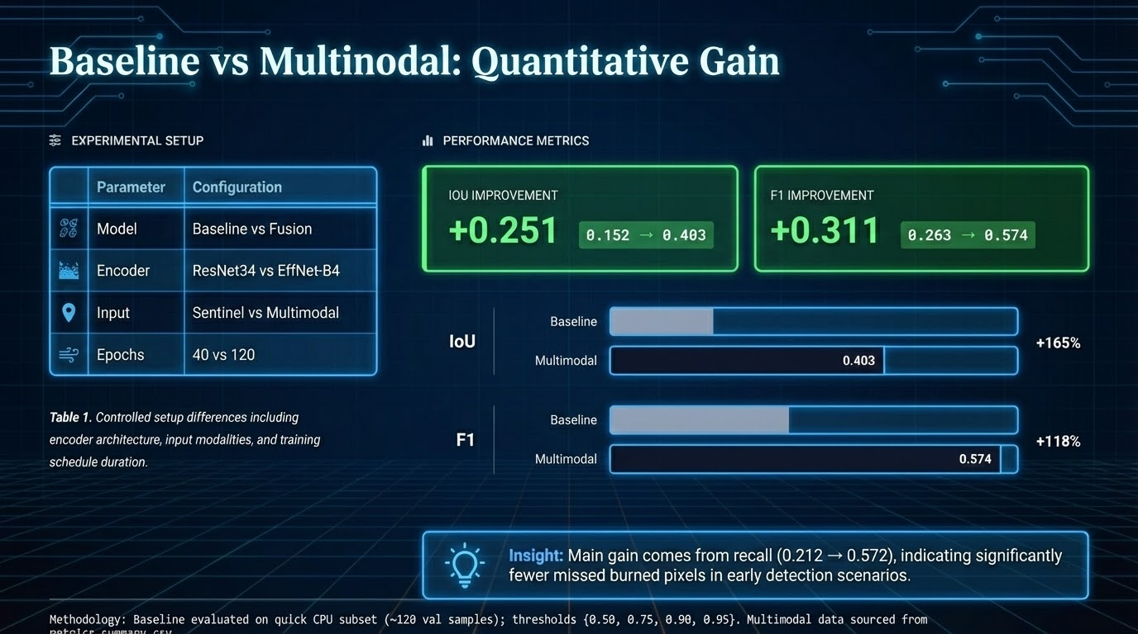

Slide 14
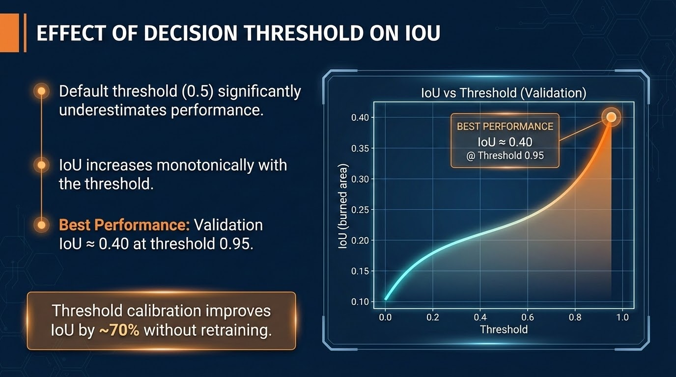

Slide 15
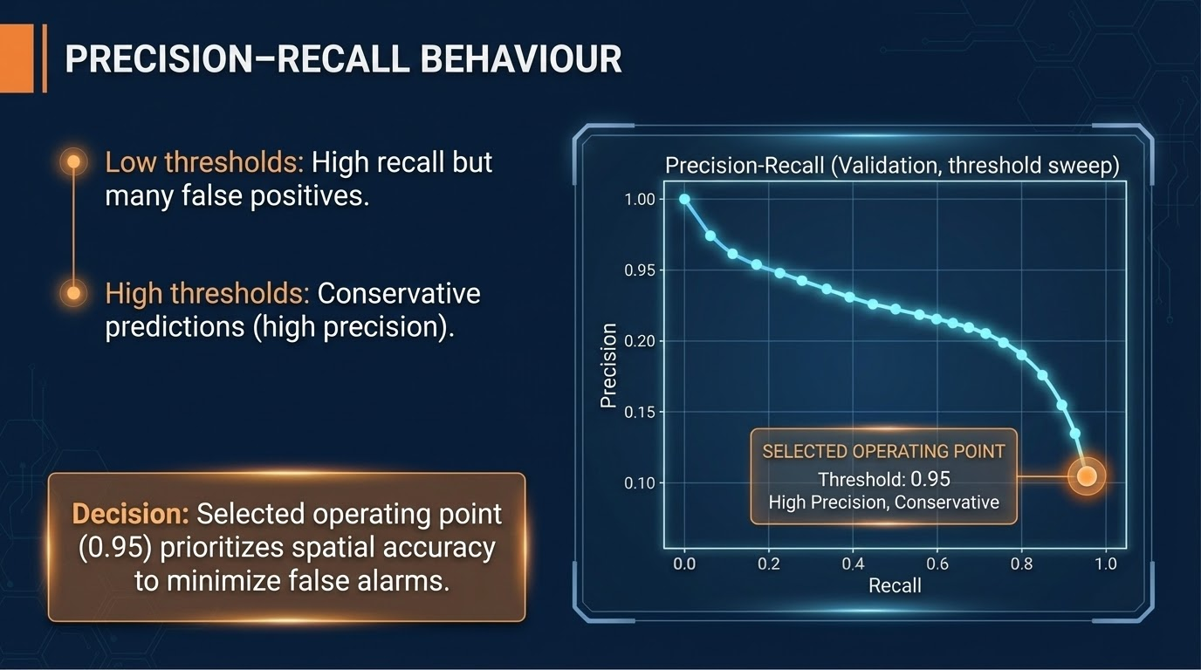

Slide 16

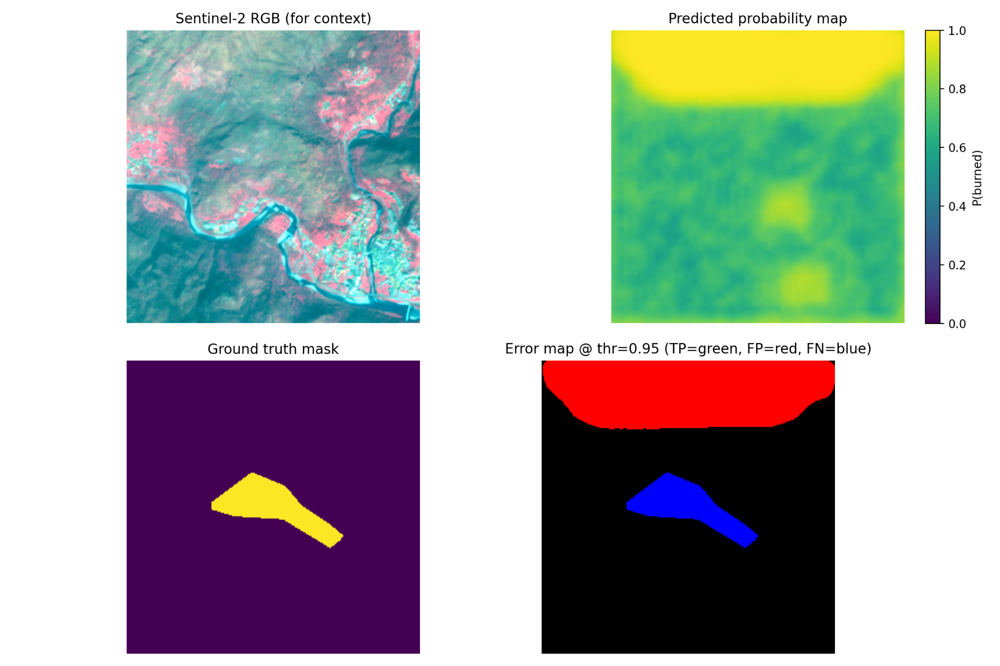
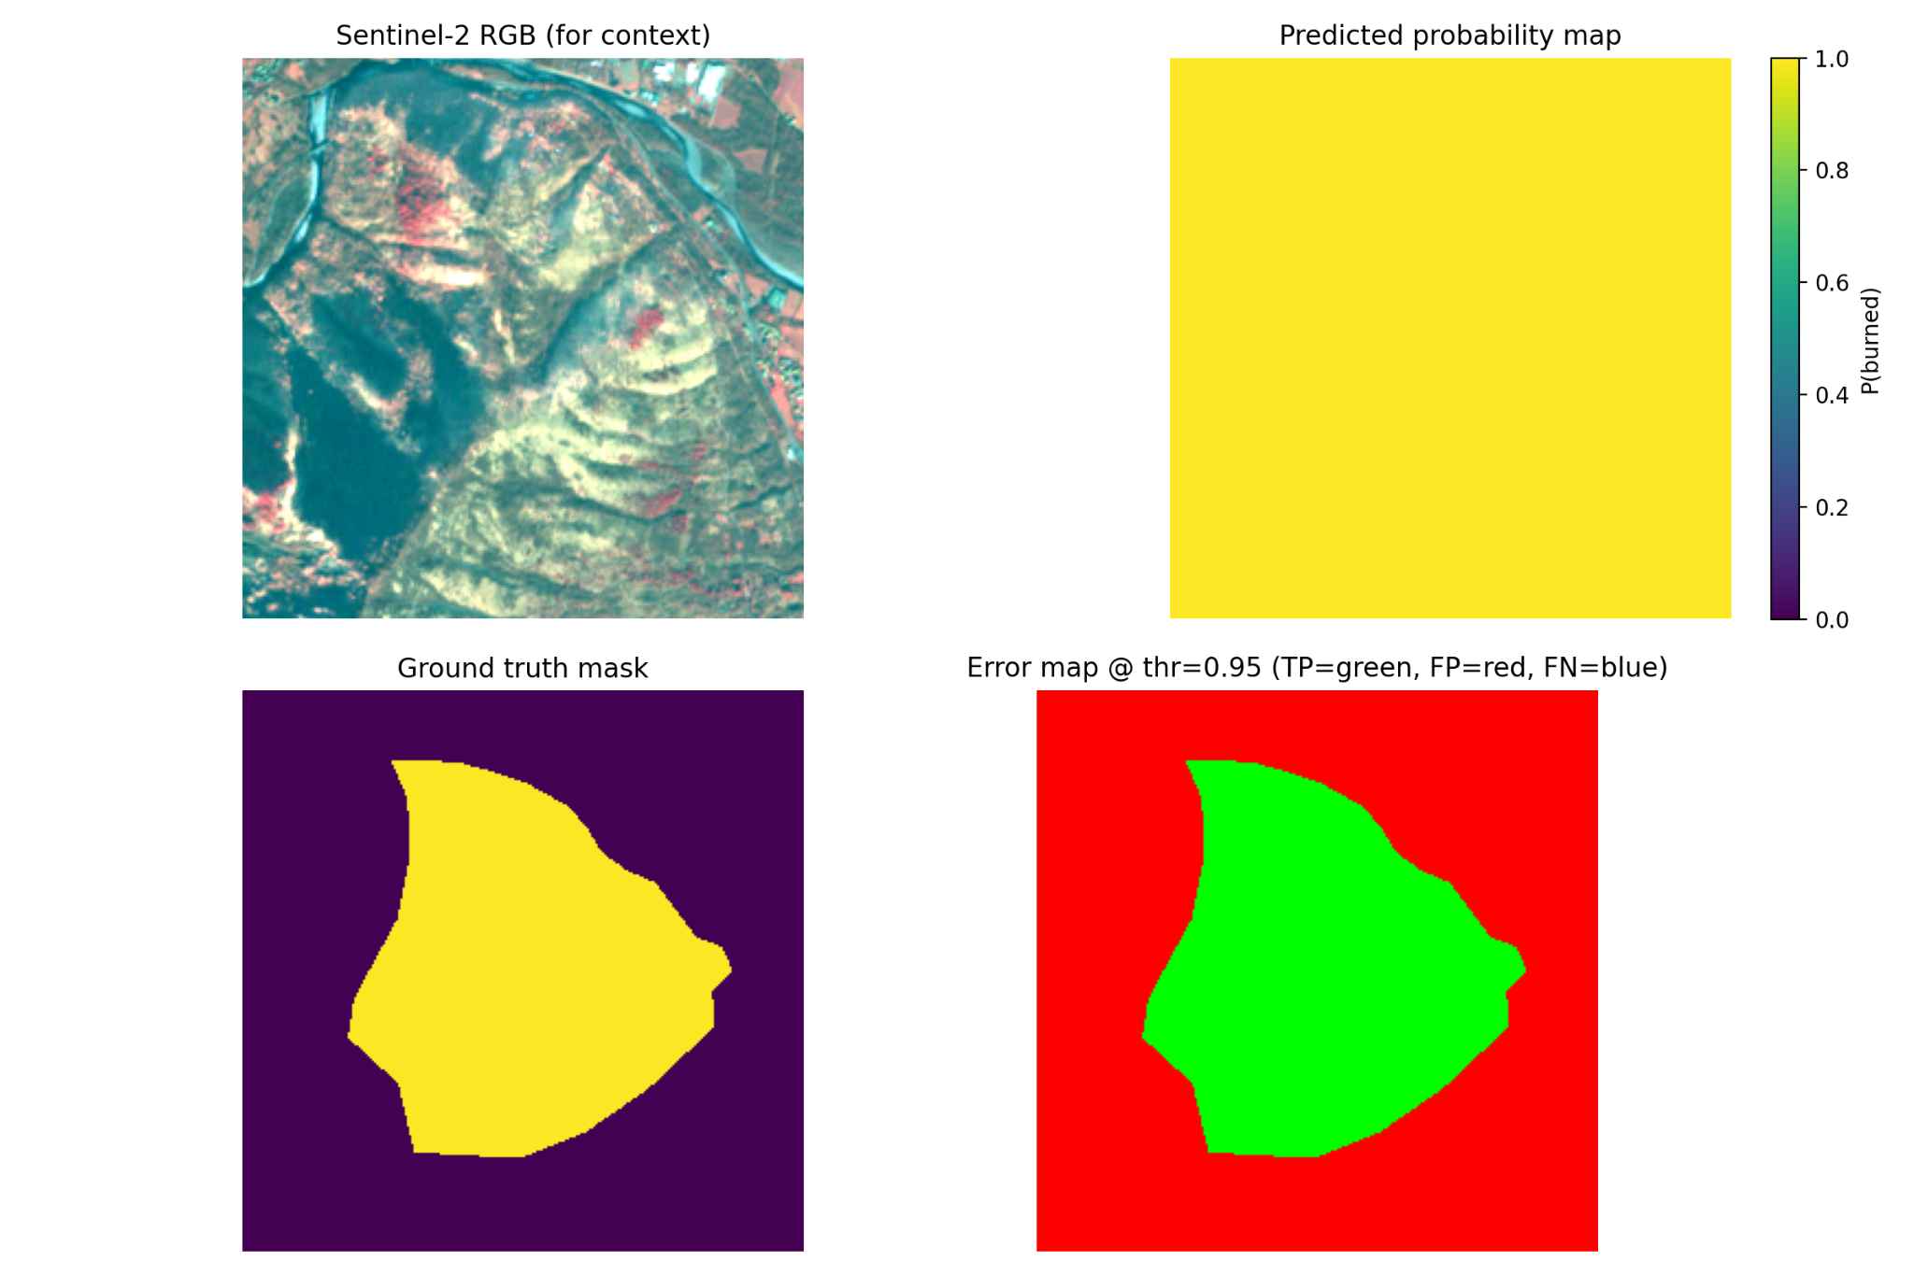

QUALITATIVE EVALUATION
SMALL / DIFFICULT FIRE
LARGE / WELL-DETECTED FIRE
Model shows conservative behavior, avoiding noise.
Large fires are detected with high spatial coherence.

Slide 17
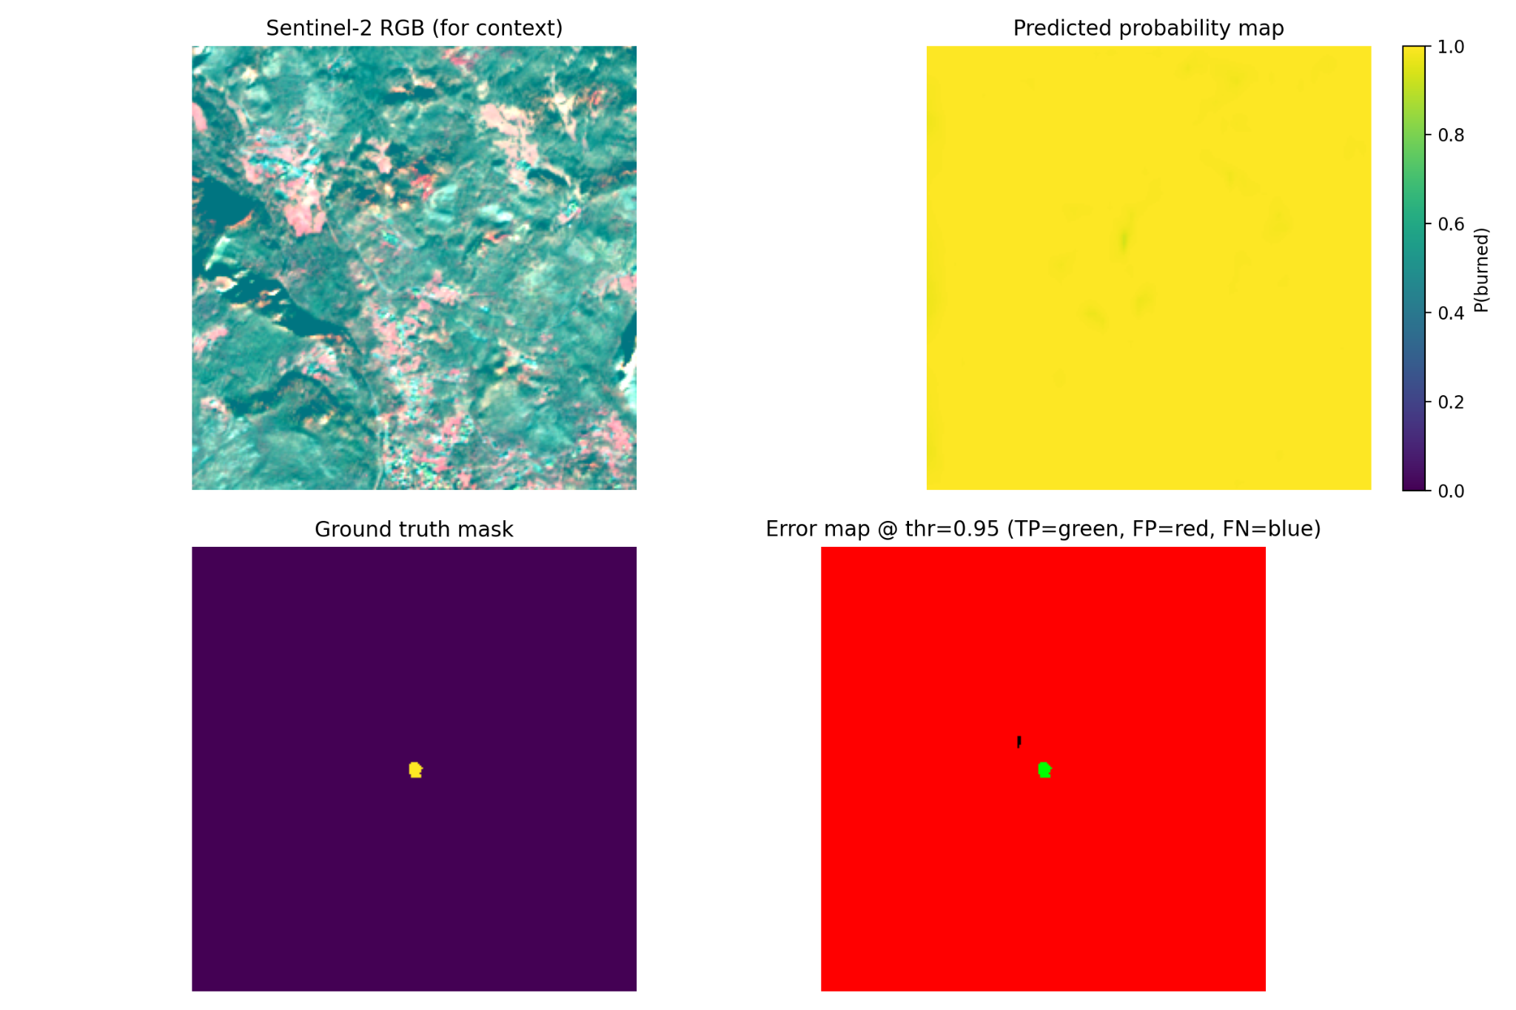
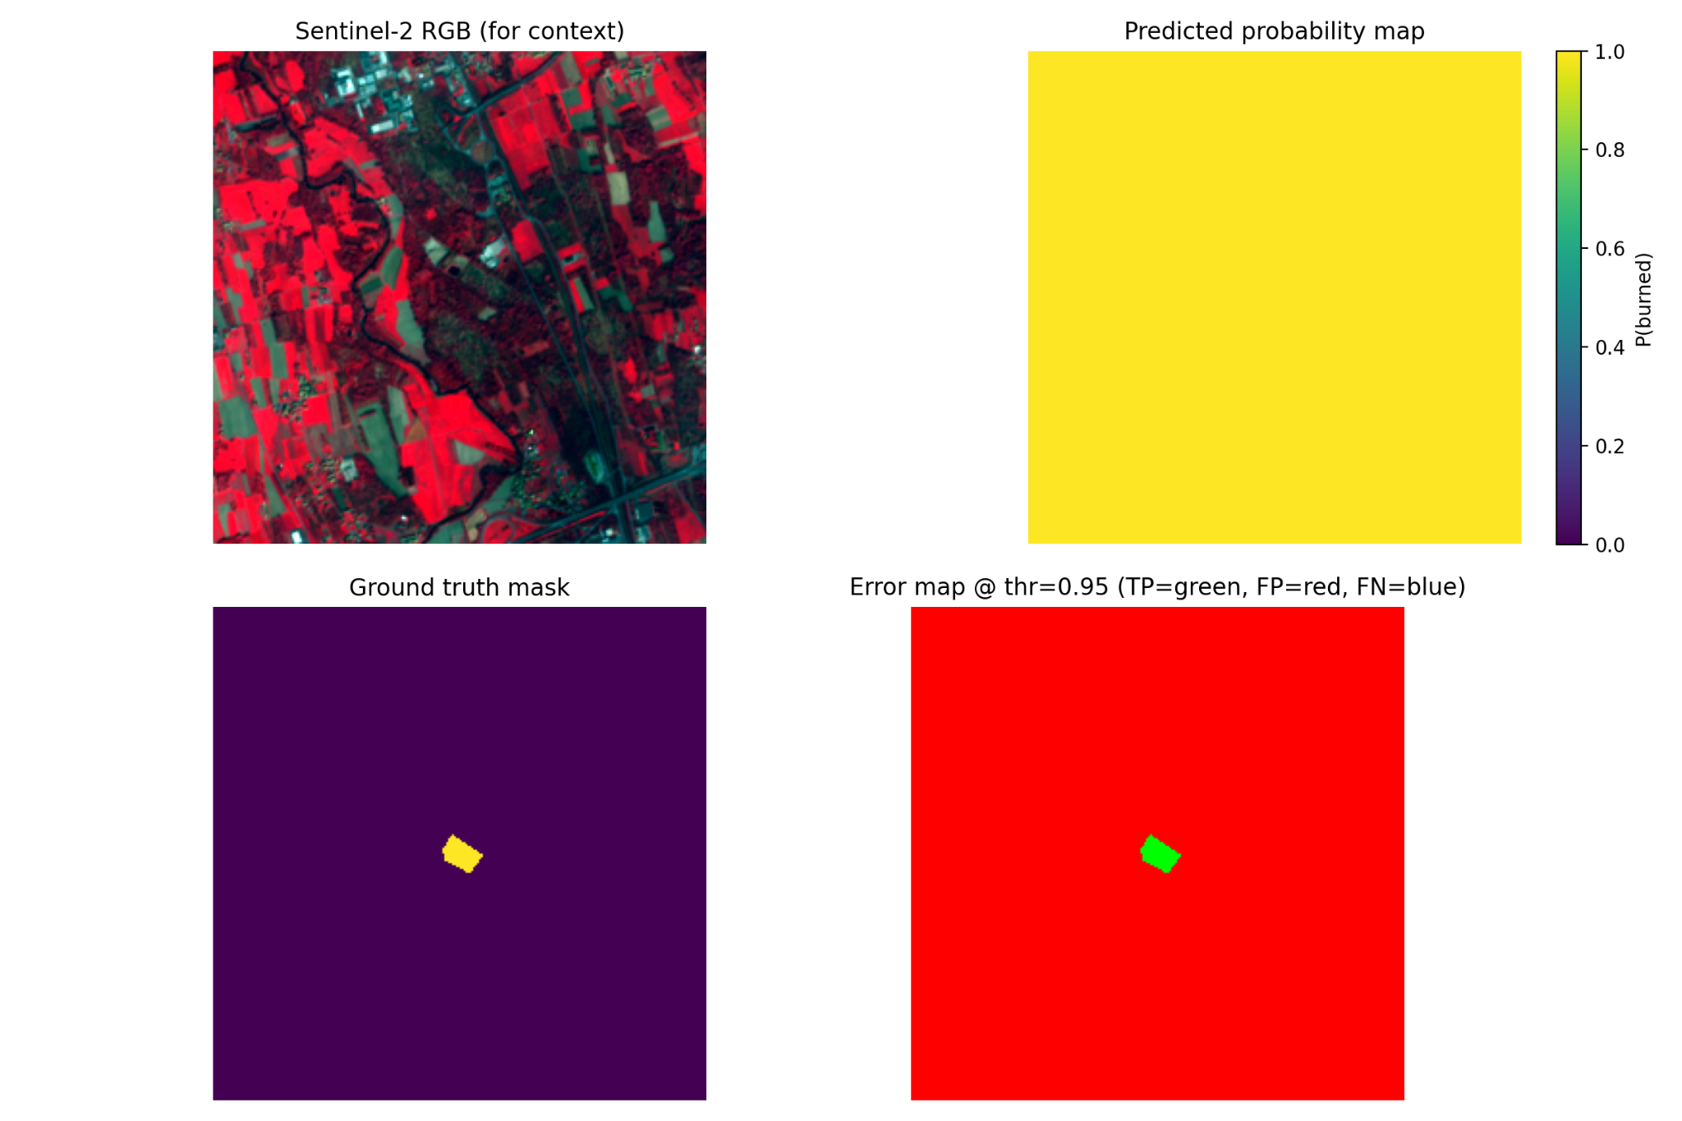
QUALITATIVE EVALUATION
SMALL / DIFFICULT FIRE
SMALL / DIFFICULT FIRE
Model shows conservative behavior, avoiding noise.
small fires are detected with normal spatial coherence.

Slide 18
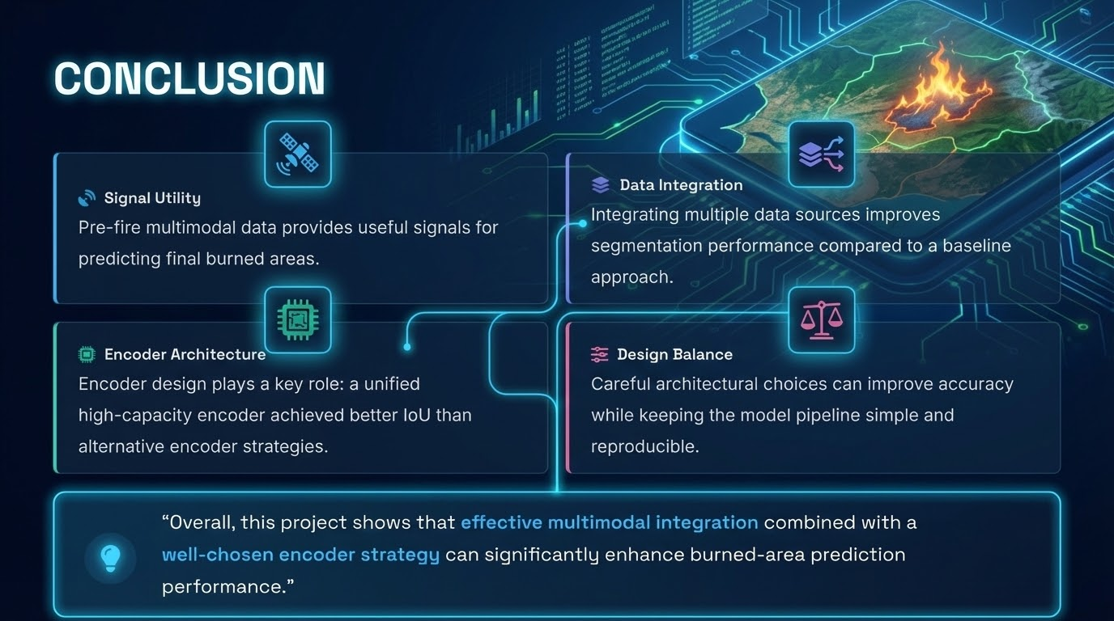

Slide 19
